Slide 1
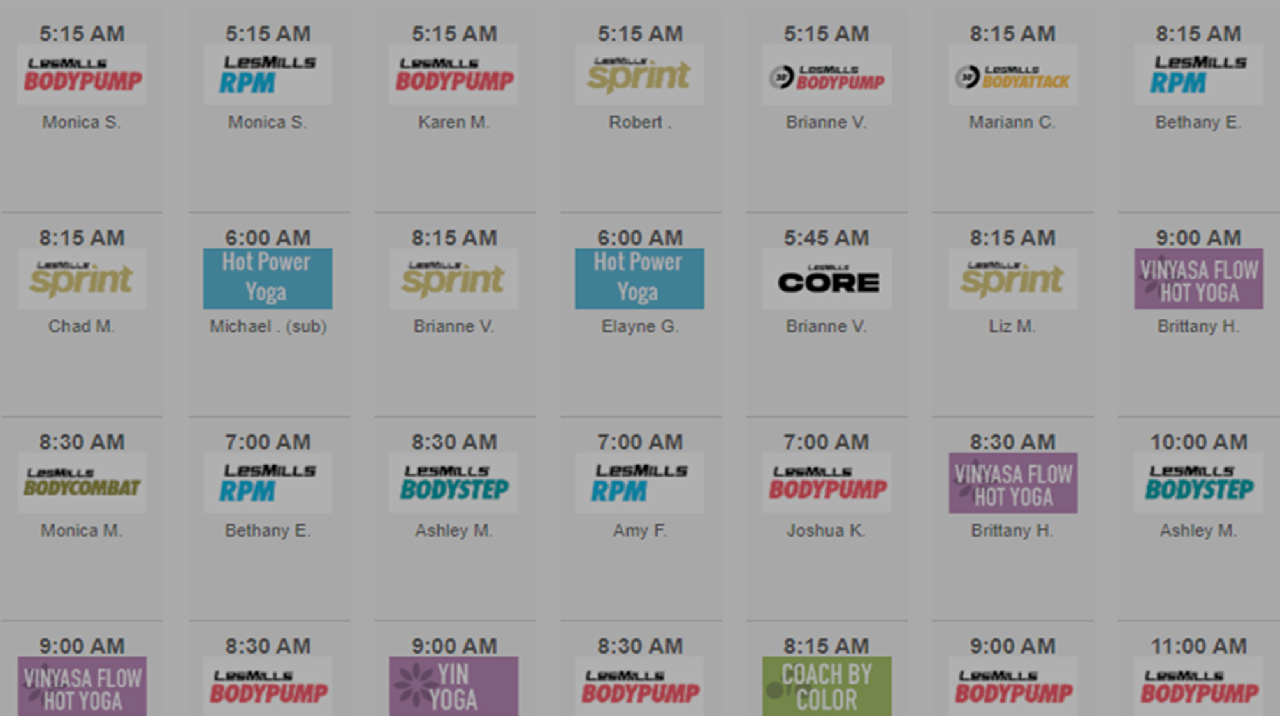
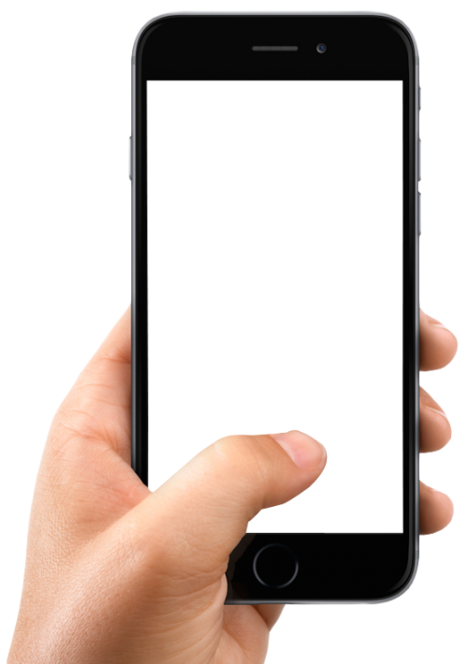
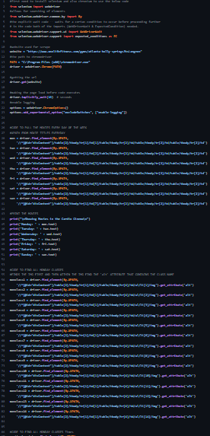
FITNESS CLASS NOTIFICATION
ALWAYS BE IN THE KNOW ABOUT
THE CLASSES YOU WANT TO TAKE
MELE KWON, TYLER SIMON, AND RILEY TUCKER
https://github.com/ksu-hmi/Fitness_notification
This Photo by Unknown Author is licensed under CC BY-NC

